Slide 1
Identificazione e controllo
Di un Robot Scara
F. Campregher
M. Milanesi
A. Msaad
Laboratorio di Automatica

Slide 2
01
Identificazione Open Loop
Validazione
02
Outline
Progettazione controllore
03
04
Implementazione
05
Taratura parametri

Slide 3
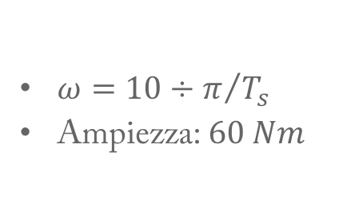
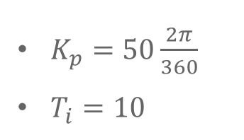
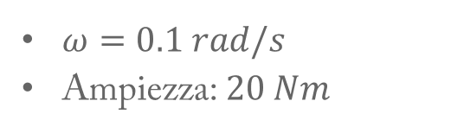
Identificazione Open Loop
Joint 2
Chirp
$ω=10÷π/{T_{s}}$
Ampiezza: $60 Nm$
$ω=0.1 rad/s$
Ampiezza: $20 Nm$
Portante
$K_{p}=50\frac{2π}{360}$
$T_{i}=10$
Controllore
PI

Slide 4
Identificazione Open Loop
Modello Joint 2

Slide 5
Identificazione Open Loop
Joint 1
Chirp
$ω=10÷π/{T_{s}}$
Ampiezza: $60 Nm$
$ω=0.1 rad/s$
Ampiezza: $20 Nm$
Portante
$K_{p}=50\frac{2π}{360}$
$T_{i}=10$
Controllore
PI

Slide 6
Identificazione Open Loop
Modello Joint 1

Slide 7

Introduction
Remarks
Tuning Effort
The use of a PIDA controller implies in any case an increment of the tuning effort.
Low-pass Filter Choice
Further, the choice of the low-pass filters to make the controller proper and to reduce the effects of the measurement noise is a critical issue.
Lack of tuning Rules
The difficulty in tuning a PIDA controller can be deduced from the lack of tuning rules.

Slide 8
Lack of PID/PIDA comparison
A complete analysis of the performance achievable by a PIDA controller in order to quantify the improvement that can be obtained with respect to a PID controller is still lacking.
It is necessary to fully investigate if using a more complex controller is paid by a significant increment of the performance.
Paper focus
In this paper we provide a comparative analysis of PID and PIDA controllers.
In particular, we optimally tune a PID and a PIDA controller by means of a genetic algorithm in order to minimize the IAE subject to a constraint on the maximum sensitivity.

Slide 9
01
Introduction
Tuning
02
Outline
Results
03
04
Conclusion
05
Future works

Slide 10
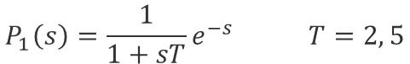
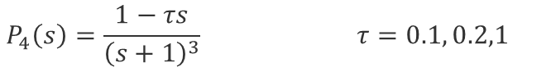
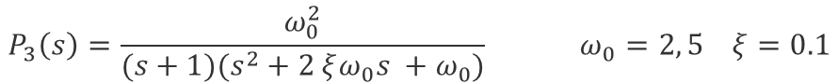
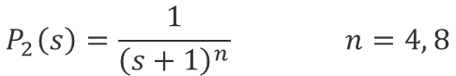
Tuning
Benchmark Processes
Time Delay and Lag
Oscillatory System
$$P_{1}\left(s\right)=\frac{1}{1+sT}e^{−s} T=2, 5$$
$$P_{3}\left(s\right)=\frac{ω_{0}^{2}}{(s+1)(s^{2}+2 ξω_{0}s +ω_{0})} ω_{0}=2, 5 ξ=0.1$$
Multiple Equal Poles
Fourth Order System
$$P_{2}\left(s\right)=\frac{1}{{\left(s+1\right)}^{n}} n=4, 8$$
$$P_{5}\left(s\right)=\frac{1}{(s+1)(1+τs)(1+τs)(1+τs^{3})} τ=0.2, 0.5$$
Right Time Half Plane Zero
$$P_{4}\left(s\right)=\frac{1−τs}{{\left(s+1\right)}^{3}} τ=0.1, 0.2,1$$
[1] K. Aström and T. Hägglund. Benchmark systems for PID control. In Preprints IFAC Workshop on Digital Control PID‘00, pages 181–182, Terrassa, E, 2000.

Slide 11
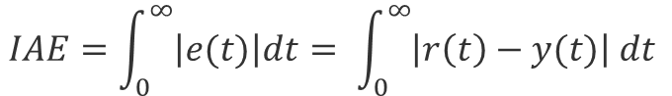
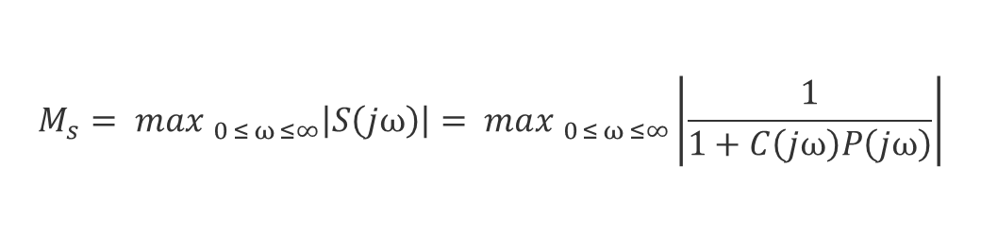
Tuning
Optimization Problem
The tuning of the PID and PIDA controllers is performed by solving a (constrained) optimization problem by means of genetic algorithms. In particular, by considering separately a set-point and a load disturbance unit step response, the integrated absolute error, defined as:
$$IAE=\int_{0}^{∞}{\left|e(t)\right|dt= \int_{0}^{∞}{\left|r\left(t\right)−y(t)\right| dt} }$$
is minimized by constraining the maximum sensitivity, defined as
$$M_{s}= max_{ 0 ≤ ω ≤∞}\left|S\left(jω\right)\right|= max_{ 0 ≤ ω ≤∞}\left|\frac{1}{1+C\left(jω\right)P\left(jω\right)}\right|$$
to the values of either $M_{s}=1.4$ or $M_{s}=2$

Slide 12
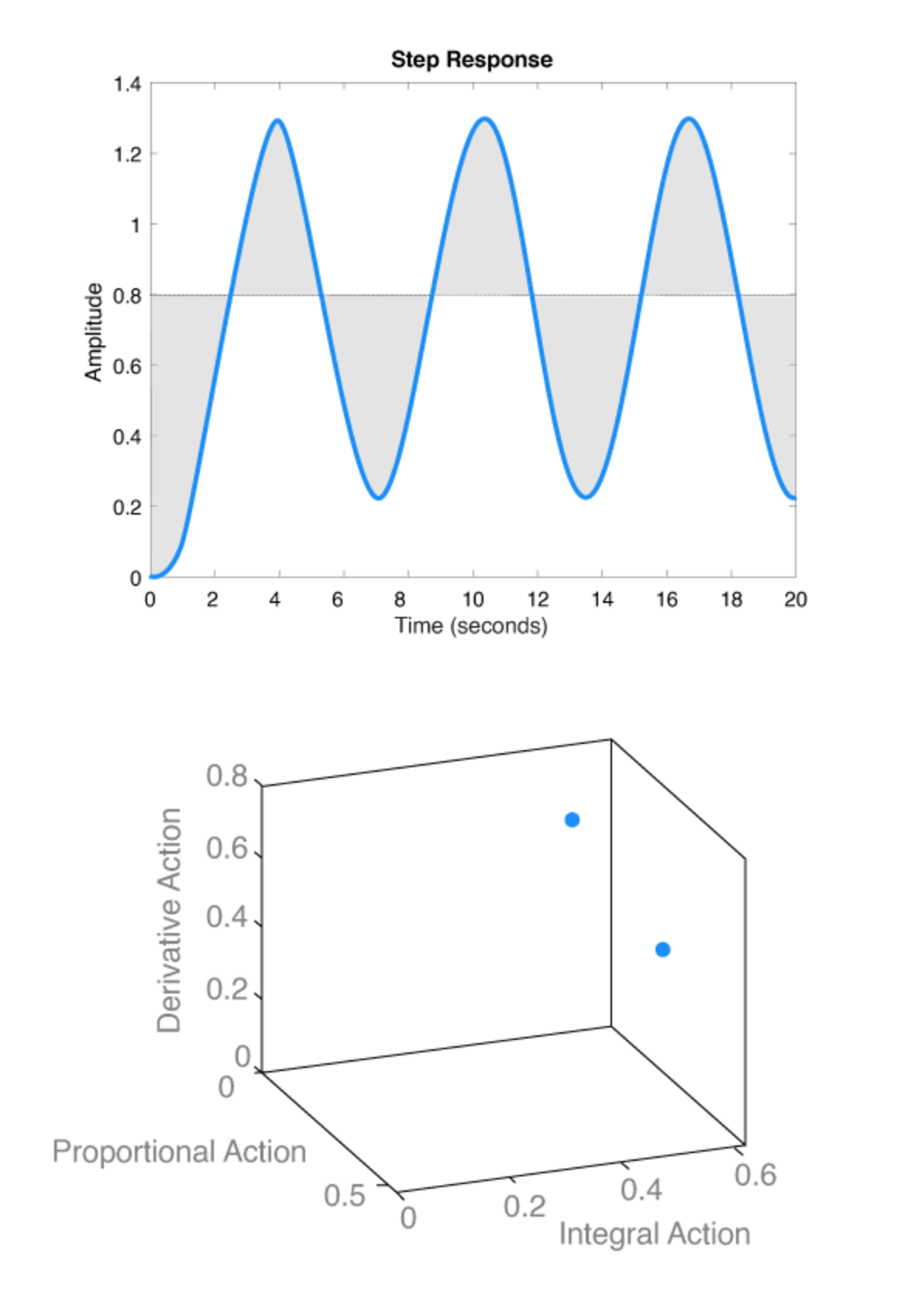











Working Principle
$$d$$
$$r$$
$$e$$
$$C$$
$$P$$
$$y$$
$$(K_{p} , T_{i} , T_{d} , N)$$
$$(K_{p} , T_{i} , T_{d} ,T_{a} , α, N)$$
$$GA$$
$$IAE= \int_{0}^{∞}{\left|e(t)\right|dt}$$
$$IAE$$

Slide 13
Tuning
Assumptions
1
No saturation
there is no saturation of the actuator and, therefore, arbitrarily big amplitudes of the control variable are allowed
2
No measurement noise
there is no measurement noise so that the low-pass filter parameters are selected by the genetic algorithm with the only aim to maximize the control performance.
In this paper we focus on the best result that can be achieved by PIDA controllers as this is the starting point to analyze the improvement of the performance they are capable to provide in practice.

Slide 14
01
Introduction
Tuning
02
Outline
Results
03
04
Conclusion
05
Future works

Slide 15
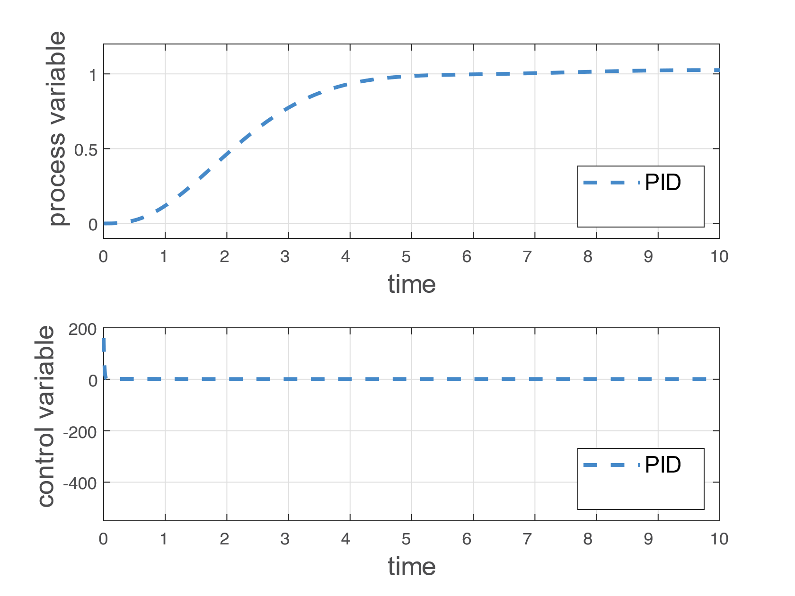
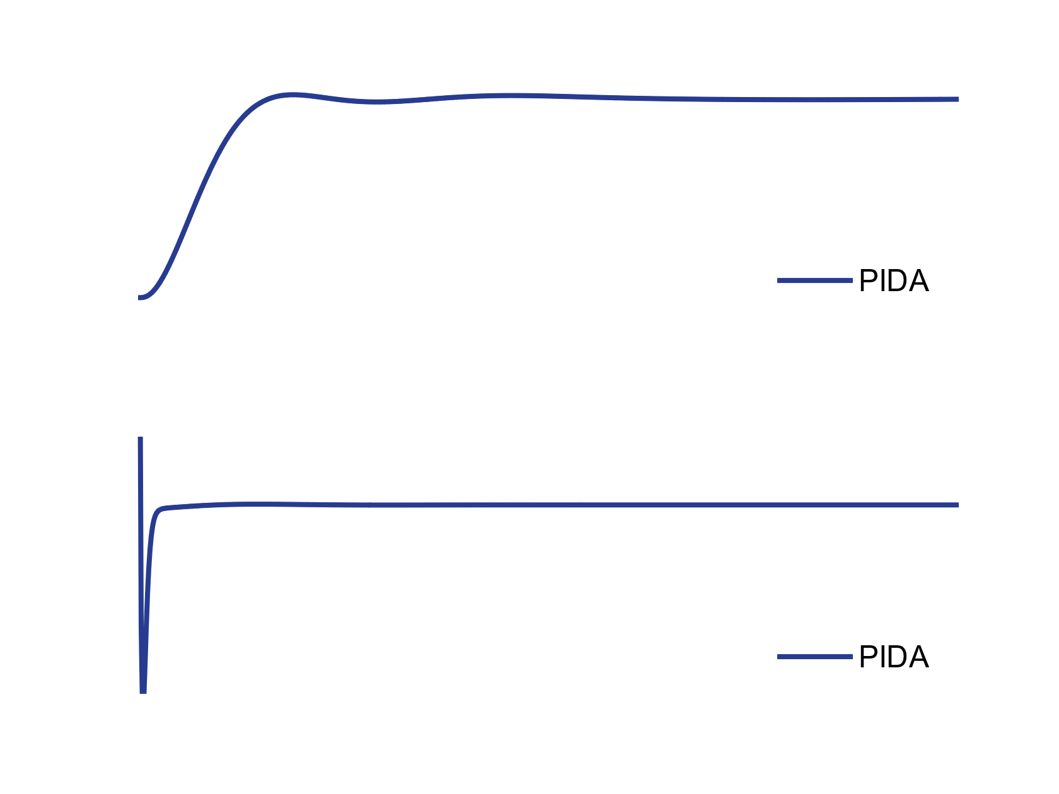
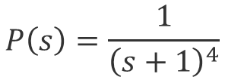
Setpoint following
$$P\left(s\right)=\frac{1}{{\left(s+1\right)}^{4}}$$
2

Slide 16
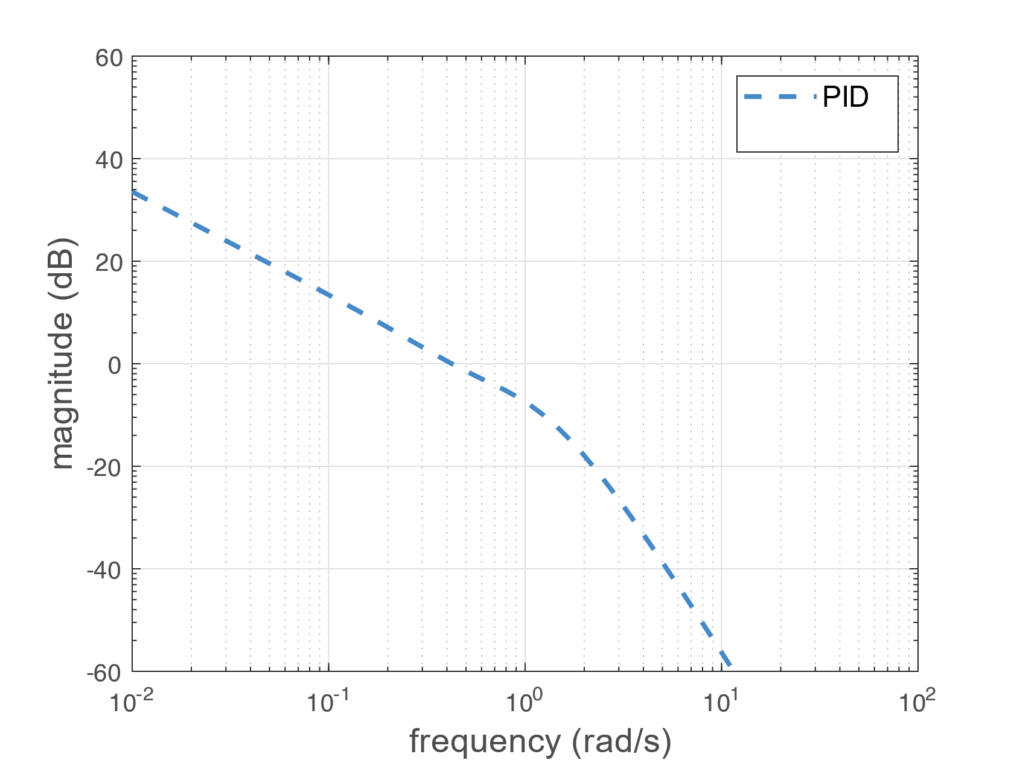
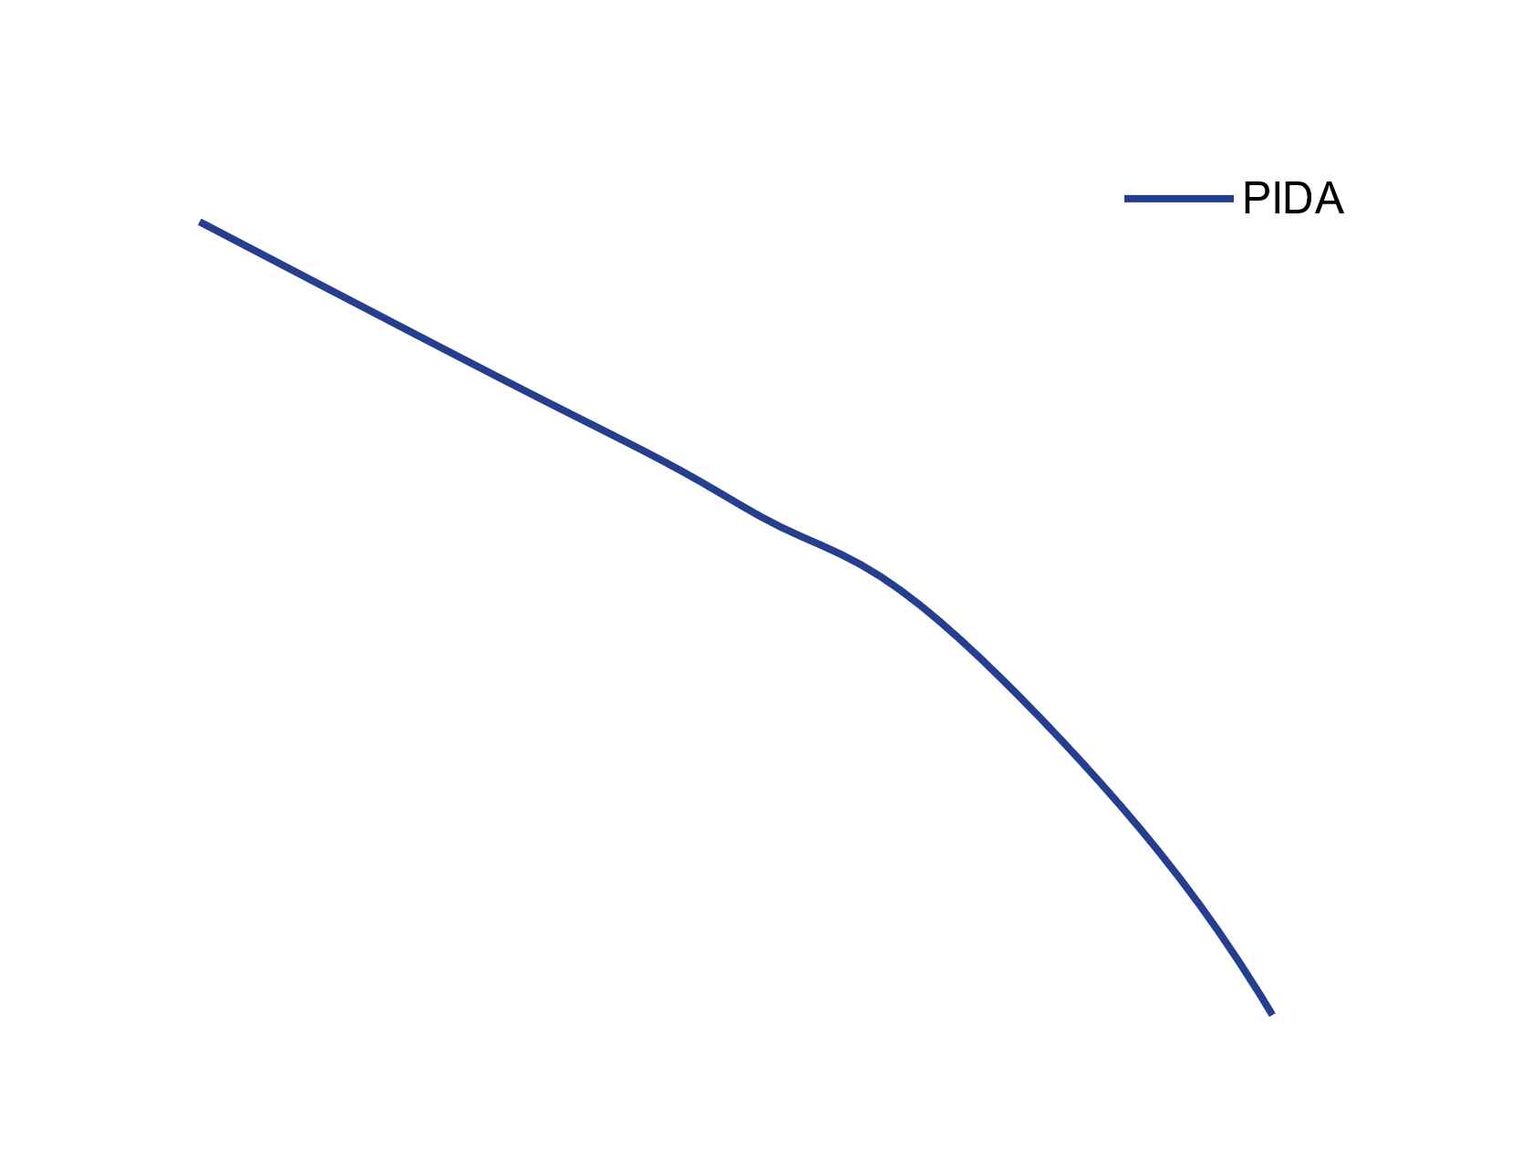
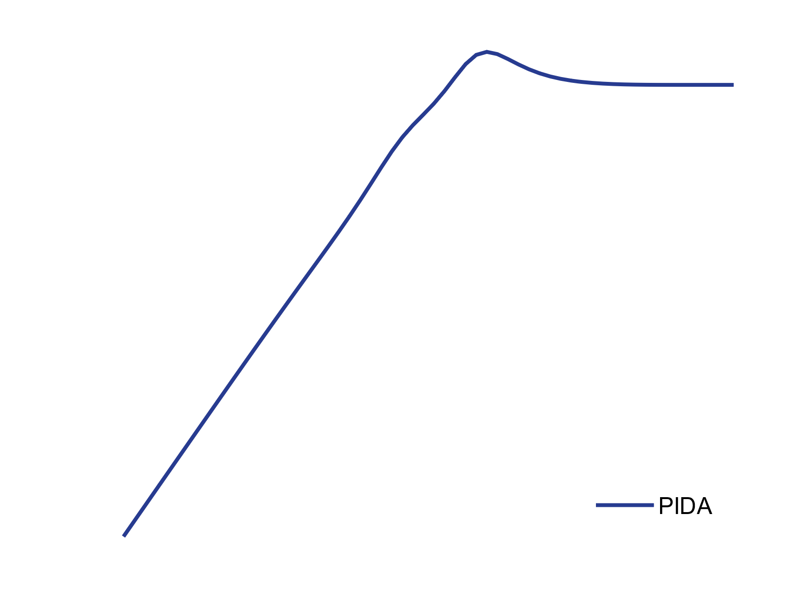
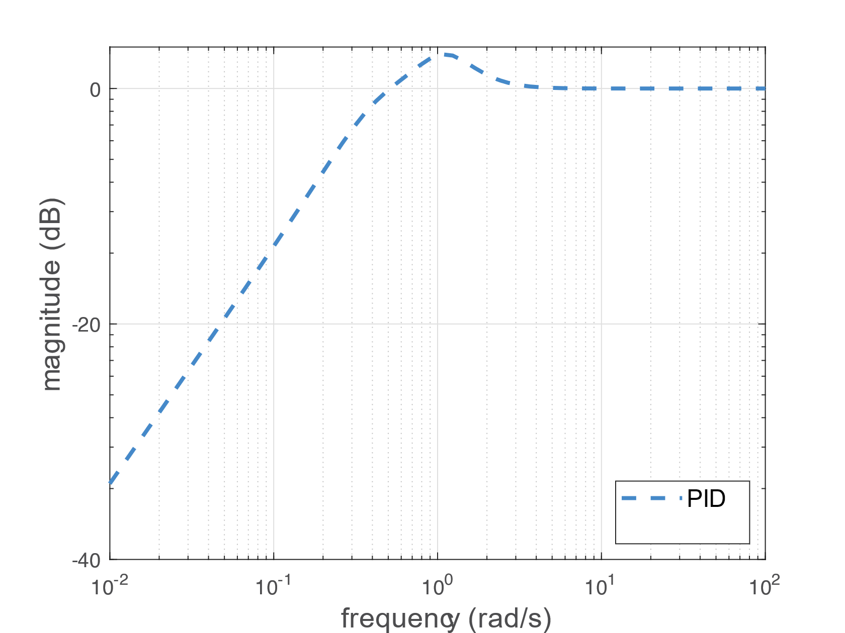

Slide 17
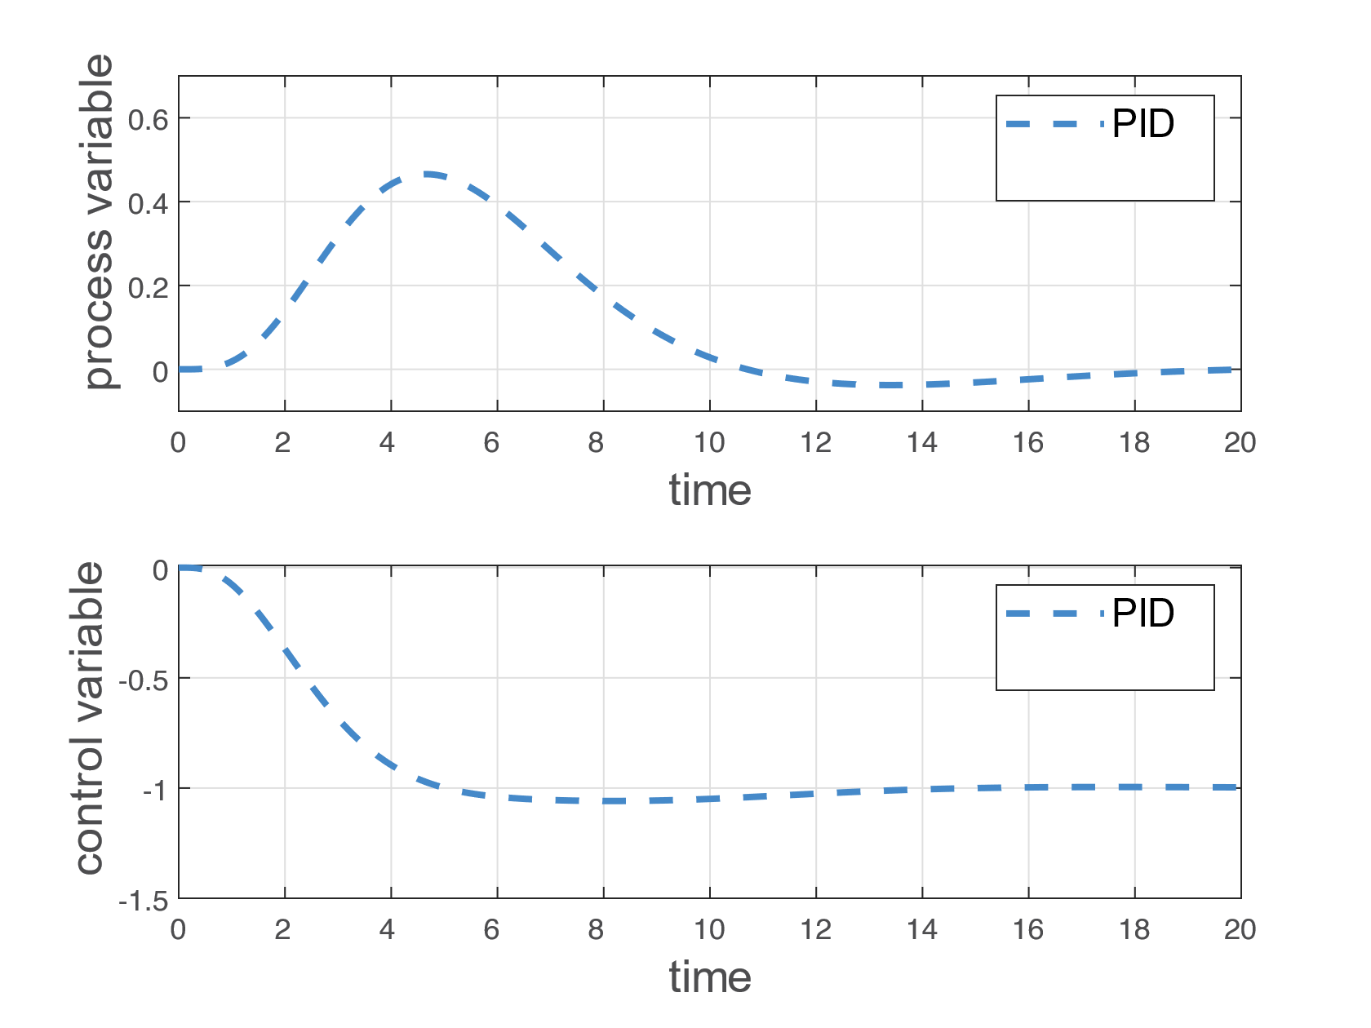
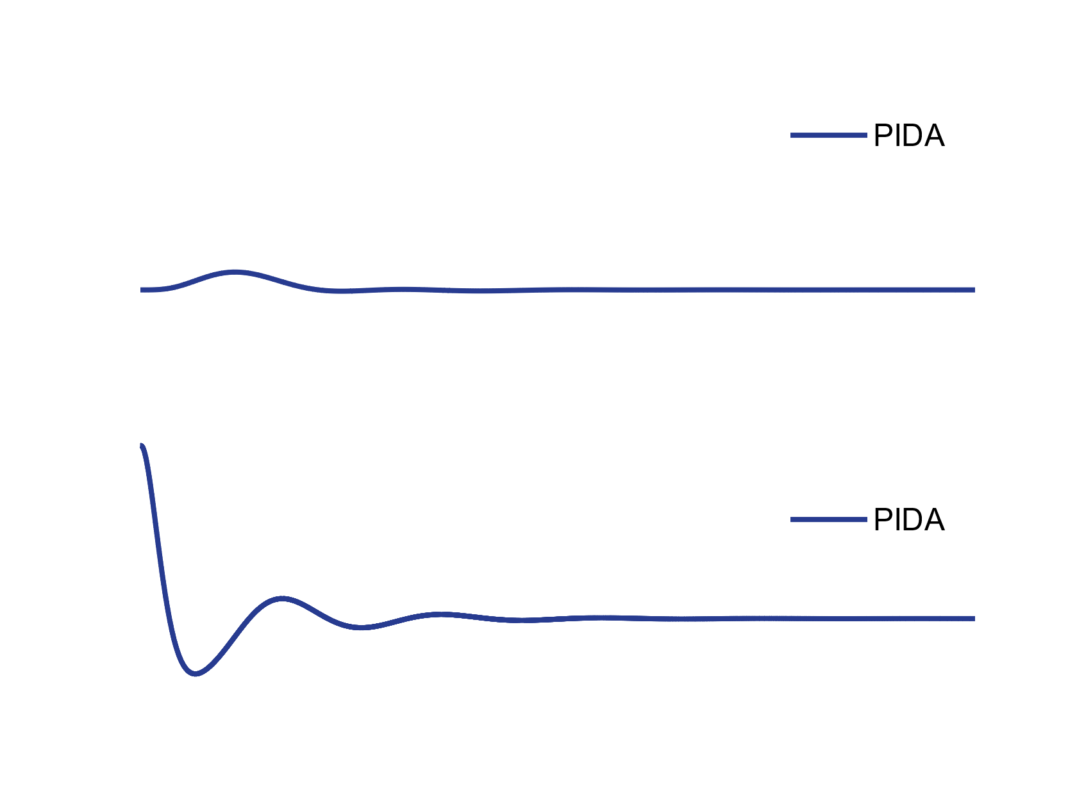
Load Disturbance Rejection
$$P\left(s\right)=\frac{1}{{\left(s+1\right)}^{4}}$$
2

Slide 18
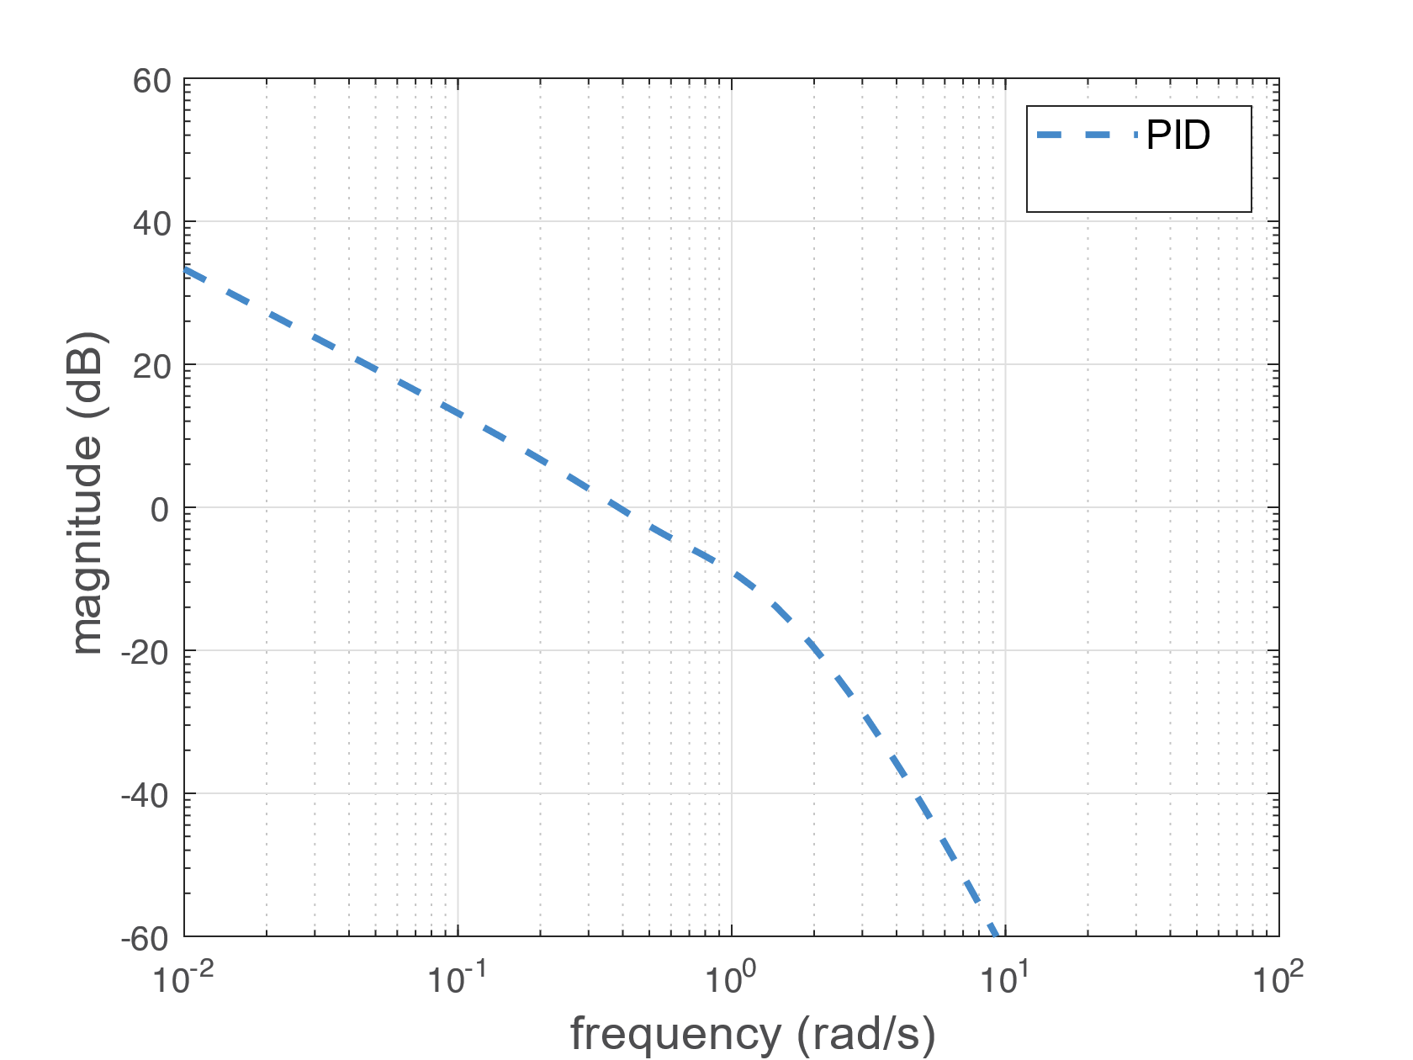
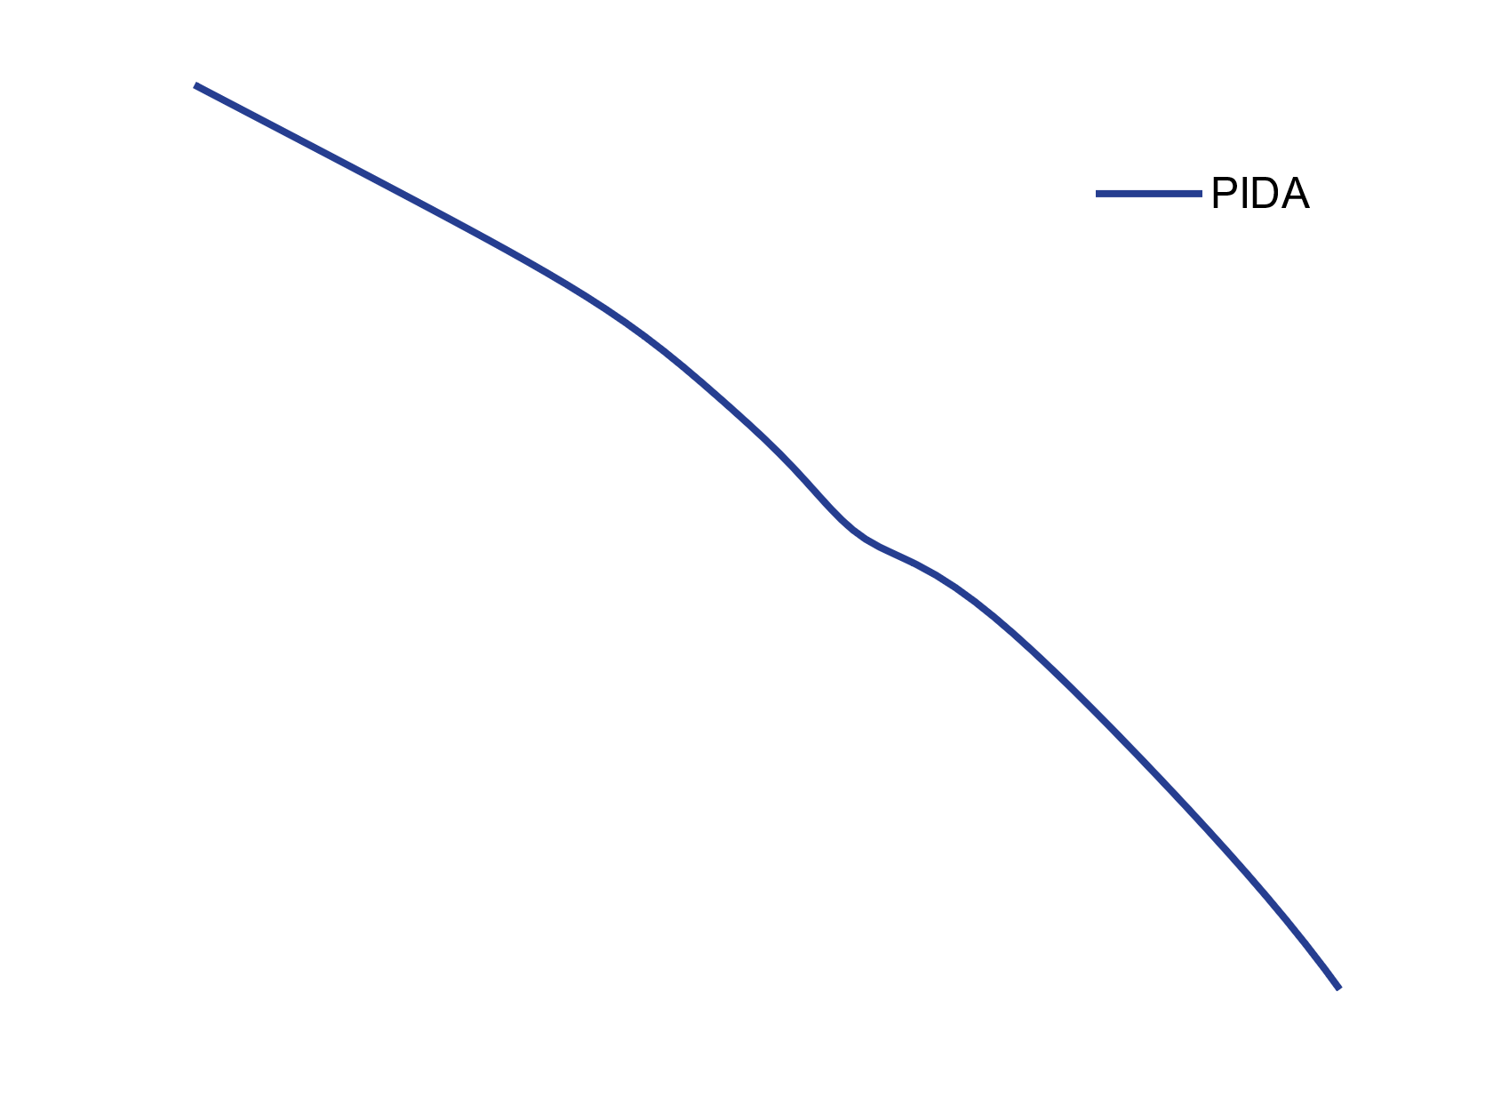
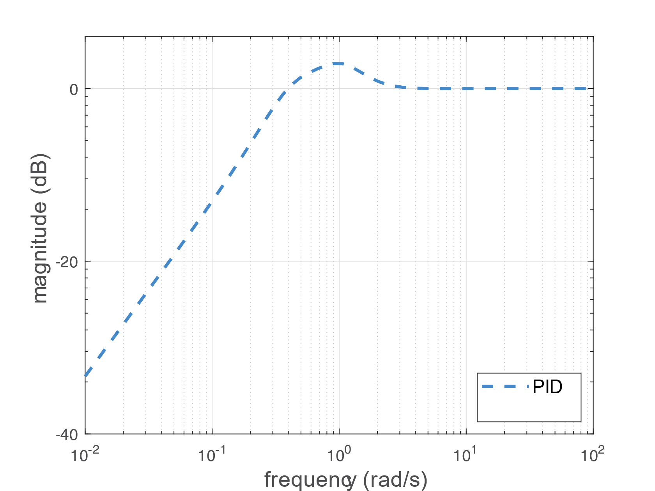
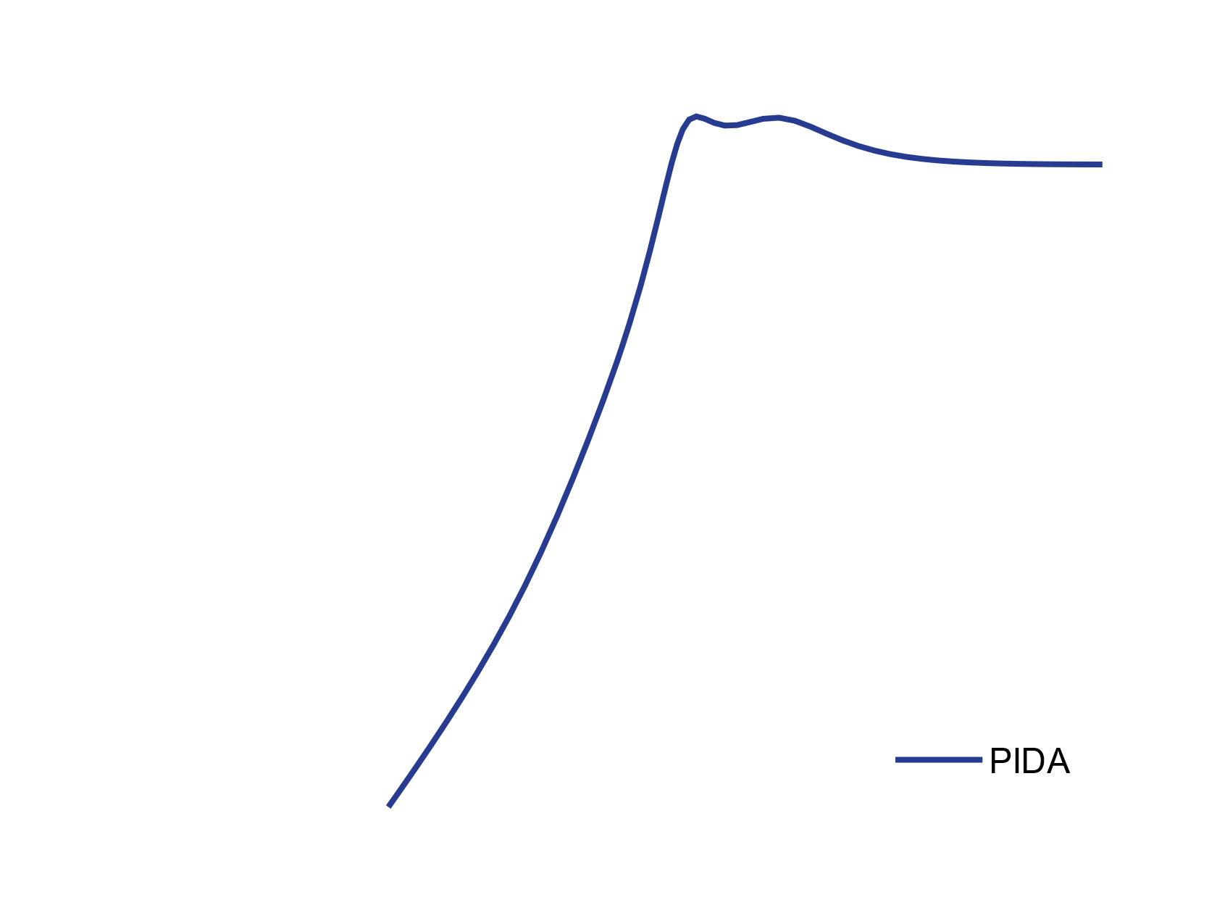

Slide 19
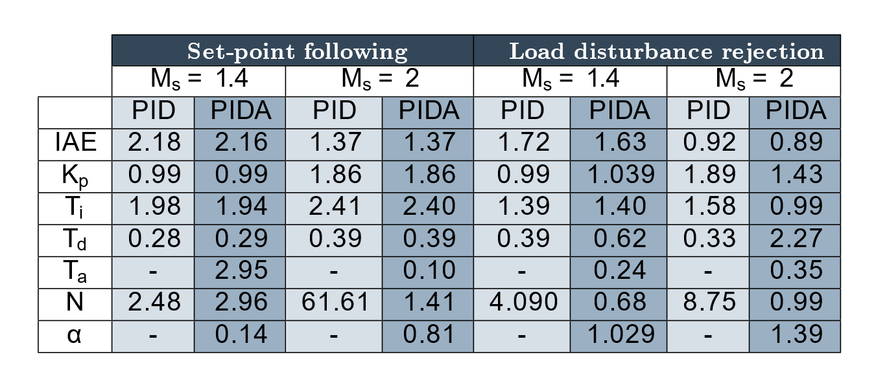
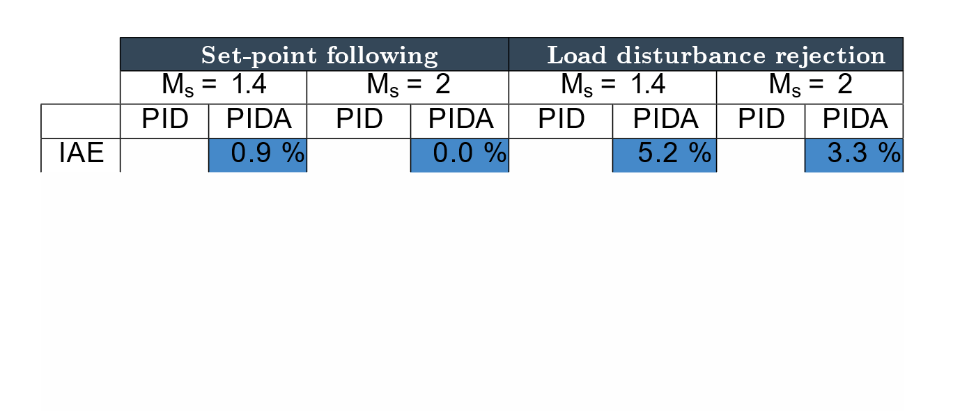
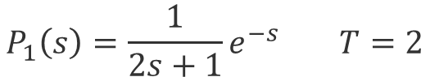
Quantitative results
$$P_{1}\left(s\right)=\frac{1}{2s+1}e^{−s} T=2$$

Slide 20
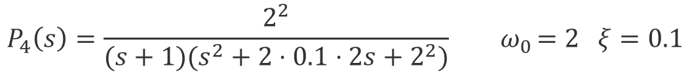
Quantitative results
$$P_{4}\left(s\right)=\frac{2^{2}}{(s+1)(s^{2}+2⋅0.1⋅2s+2^{2})}{ ω}_{0}=2 ξ=0.1$$
Set-point following
Load disturbance rejection
M
=
1
.
4
M
=
2
M
=
1
.
s
s
s
4
M
=
2
s
PID
PIDA
PID
PIDA
PID
PIDA
PID
PIDA
96.0 %
0.019
IAE
2.26
0.19
1.59
0.064
2.021
1.39
99.9 %
91.6 %
99.1 %
0.0015
K
0.10
5.49
0.26
22.92
0.13
15.40
0.25
64.39
p
T
0.21
0.93
0.24
0.81
0.16
0.14
0.21
0.044
i
T
1.24
0.37
1.28
0.67
2.39
3.12
2.63
15.33
d
T
-
0.31
-
0.40
-
0.34
-
0.39
a
N
15.33
1.17
41.73
1.55
110.26
8.015
110.21
26.27
α
-
7.40
-
31.15
-
26.92
-
67.79

Slide 21
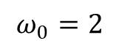
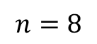
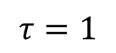
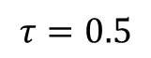
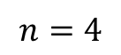
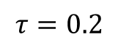
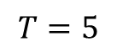
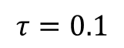
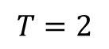
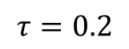
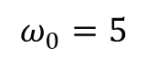
Results
Summary
Set-point following
Load disturbance rejection
Process
M
=
1
.
4
M
=
2
M
=
1
.
s
s
s
4
M
=
2
s
P
$$T=2$$
0.9%
0.0%
5.2%
3.3%
1
$$T=5$$
3.9%
1.4%
4.1%
1.8%
P
$$n=4$$
64.8%
68.8%
95.3%
97.7%
2
$$n=8$$
43.4%
37.3%
40.5%
25.8%
P
$$τ=0.2$$
79.0%
79.3%
92.6%
92.2%
3
$$τ=0.5$$
64.7%
82.1%
40.6%
93.8%
P
$$ω_{0}=2$$
91.6%
96.0%
99.1%
99.9%
4
$$ω_{0}=5$$
96.8%
97.4%
99.7%
99.8%
P
$$τ=0.1$$
42.0%
73.5%
48.3%
72.7%
5
$$τ=0.2$$
24.3%
49.6%
30.8%
49.3%
$$τ=1$$
14.9%
15.5%
15.9%
11.3%

Slide 22
01
Introduction
Tuning
02
Outline
Results
03
04
Conclusion
05
Future works

Slide 23
Conclusions
We have analysed the performance improvement that can be achieve by adding the acceleration action to PID Controller
01
Reduction of IAE
Results obtained with different process show that the integrate absolute error (IAE) can be significantly reduced (without lowering the robustness) for high-order processes
Additional zeros
02
Indeed, the additional zeros in the controller and the consequent phase lead they yield, allow an increment of the bandwidth of the control system without increasing the maximum sensitivity

Slide 24
03
More investigation is worth
Although the analysis has been performed in ideal conditions (without any saturation limit of the control action and in the absence of noise), they clearly indicate that it is worth investigating more this kind of controllers as they might represent a valid alternative to standard PID controllers when the dynamics of the process is relatively complex and there are tight control requirements

Slide 25
01
Introduction
Tuning
02
Outline
Results
03
04
Conclusion
05
Future works

Slide 26
It is necessary on one hand to demonstrate that they are able to significantly improve the performances (in order to justify the increment of the controller complexity)
On the other hand, to provide automatic tuning methodologies in order to reduce the design effort of the controller
In order to foster
the use of PIDA
controllers in industry
Notes:
Before I delve into the possible future research, I would like to share with you an exciting development.
Recently, a new article has been published which showcases the potential use of PIDA controllers not in ideal conditions. This article is based on the findings that we have just obtained through our own research.
I am thrilled to present this article to you today as it demonstrates the significance and relevance of our work.

Slide 27
Future work
Automatic Tuning
1
A relay-feedback automatic tuning methodology of PIDA controllers for high-order processes
In [2] they propose a new closed-loop automatic tuning methodology for PIDA controllers that consists of two steps. First, a relay-feedback experiment is performed, and a high-order transfer function of the process is estimated. Then, the PIDA controller is tuned by applying an internal model control (IMC) approach
[2] Antonio Visioli & José Sánchez-Moreno (2022) A relay-feedback automatic tuning methodology of PIDA controllers for high-order processes, International Journal of Control
Notes:
In the paper outlined in 2, professor Visioli et al. have proposed a relay-feedback […]

Slide 28
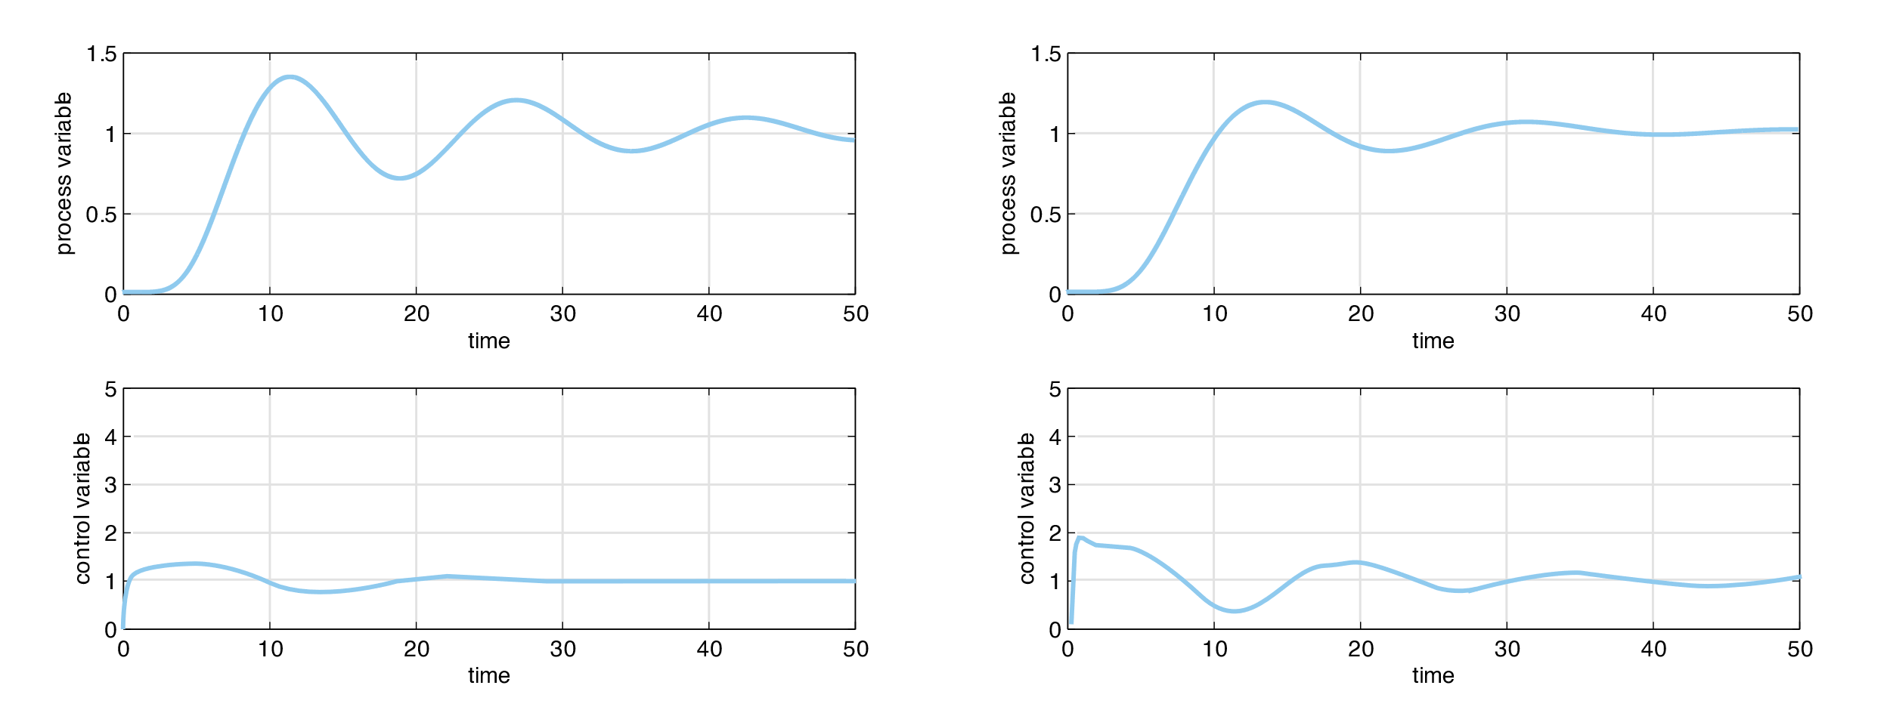
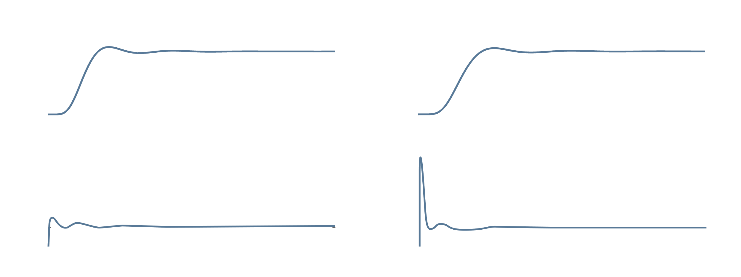
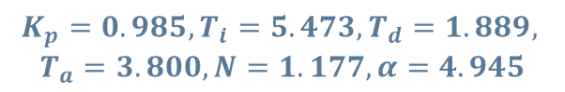
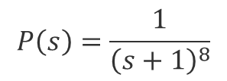
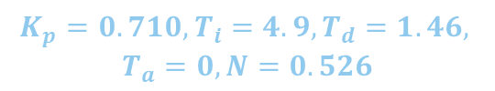
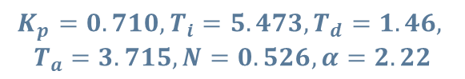
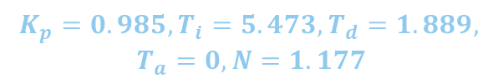
Future work
Illustrative Example
$$P\left(s\right)=\frac{1}{{\left(s+1\right)}^{8}}$$
$$K_{p}=0.985, T_{i}=5.473, T_{d}=1.889,$$
$$T_{a}=0, N=1.177$$
$$K_{p}=0.710, T_{i}=4.9, T_{d}=1.46,$$
$$T_{a}=0, N=0.526$$
$$K_{p}=0.985, T_{i}=5.473, T_{d}=1.889,$$
$$T_{a}=3.800, N=1.177, α=4.945$$
$$K_{p}=0.710, T_{i}=5.473, T_{d}=1.46,$$
$$T_{a}=3.715, N=0.526, α=2.22$$
Notes:
The example displayed on this slide illustrates that with proper tuning, the PIDA system can exhibit superior performance without causing any negative effects on the control variable. This achievement was made possible by our thorough understanding of the true capabilities of PIDA, as compared to PID. Furthermore, we gained insights into which processes the PIDA system is better suited for, which was the primary objective of our study.
I would like to draw your attention to the data presented, which clearly demonstrates that by simply adding the acceleration action to the system while keeping the controller parameters constant for both PID and PIDA, we observe an improvement in the system's response. It is important to note that this enhancement is achieved with only a slight increase in the control variable.

Slide 29
Future work
2
FOPIDA or $PI^{λ}D^{μ}A^{υ}$
In [3] it was found that the FOPIDA controller could provide very satisfactory input-tracking and load-regulating responses of the drive train system better than the IOPID, FOPID and IOPIDA controllers.
3
PID-FOA or $PIDA^{2α}$ where $0.5≤α≤1.5$
Insert a fractional part in the alpha-derivative part of the controller
[3] M. Cheunpirom, A. Nawikavatan and D. Puangdownreong, "Fractional-Order PIDA Controller Design by Cuckoo Search for Drive Train System," 2020 Joint International Conference on Digital Arts, Media and Technology, Pattaya, Thailand, 2020
Notes:
One option that shows great promise is to make the entire PIDA controller fractional order. A recent study in [3] has demonstrated that using a FOPIDA controller yields better results for the drive train system compared to integral and fractional PID controllers, as well as the integral PIDA controller. However, while this option has not yet been generalized, it is worth exploring, despite the additional design effort required due to the addition of three more parameters.
Another option that shows promise is to have only the acceleration part of the controller be fractional order, known as a PID-FOA or PIDA 2 alpha. While this option would require only a slight increase in design effort by adding just one more parameter, it has the potential to yield significant improvements in performance.

Slide 30
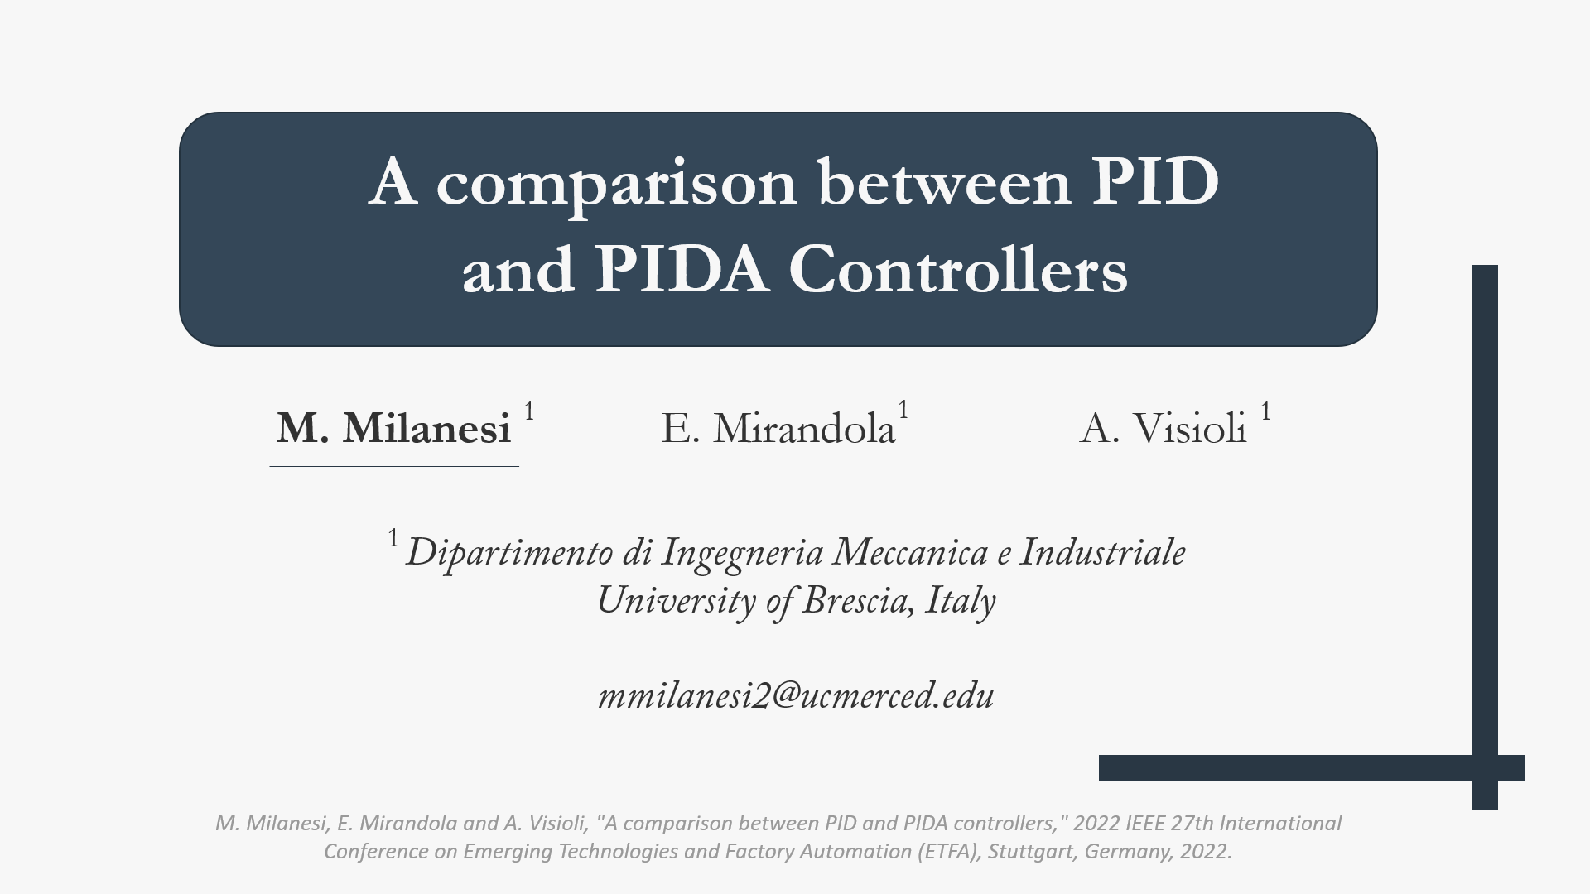
Thanks for your attention
Notes:
I hope that this presentation has been informative and engaging, and that you now have a better understanding of how PIDA can be used to achieve better results in various applications.
I would like to take a moment to express my sincere thanks for your time and attention today. I appreciate the opportunity to share our research
Thank you again, and please don't hesitate to reach out if you have any questions

Slide 31
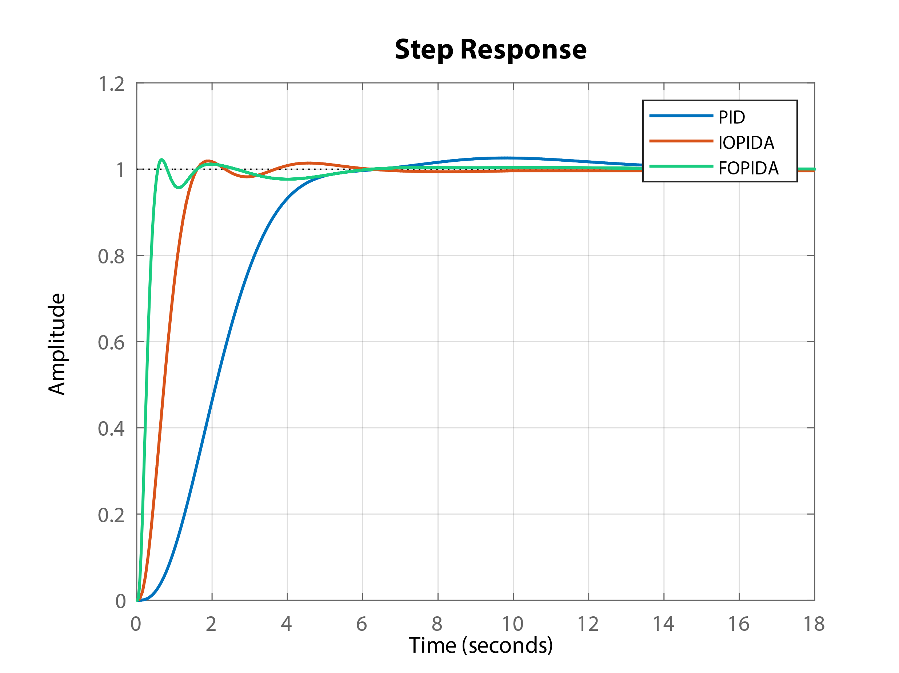
Notes:
And here I present the preliminary results of a simulation that I just launched yesterday. These initial findings are indeed promising, suggesting a potentially favorable outcome.

Slide 32
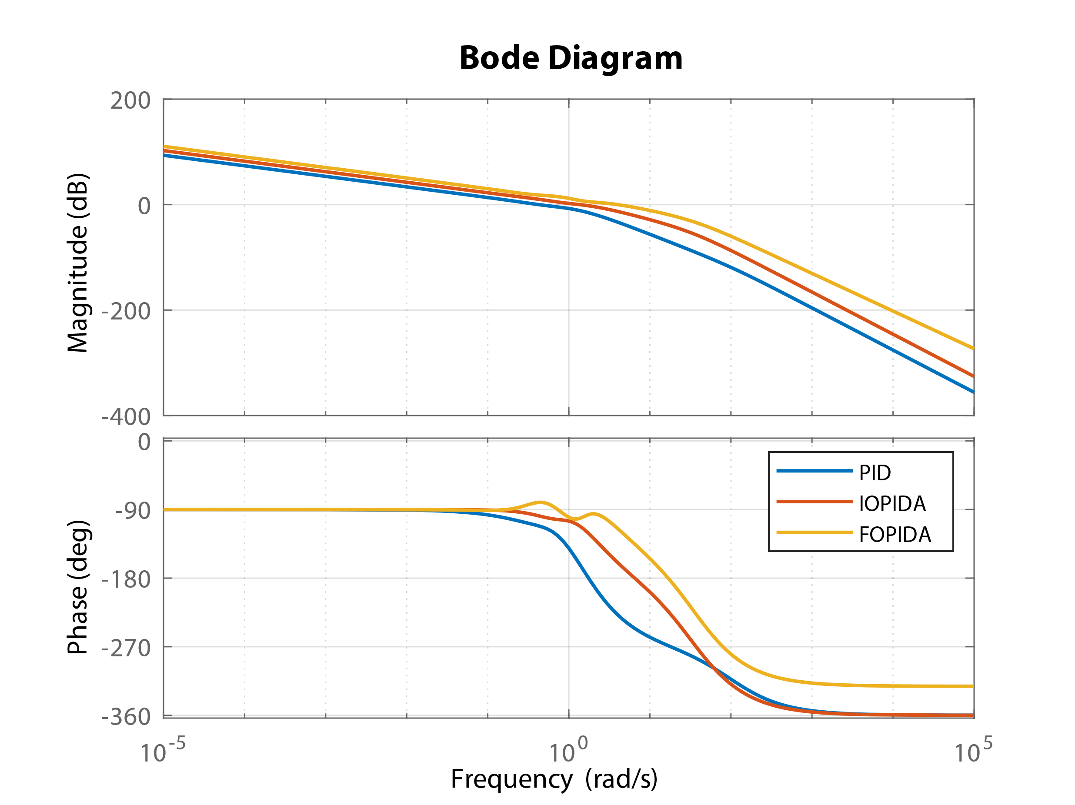
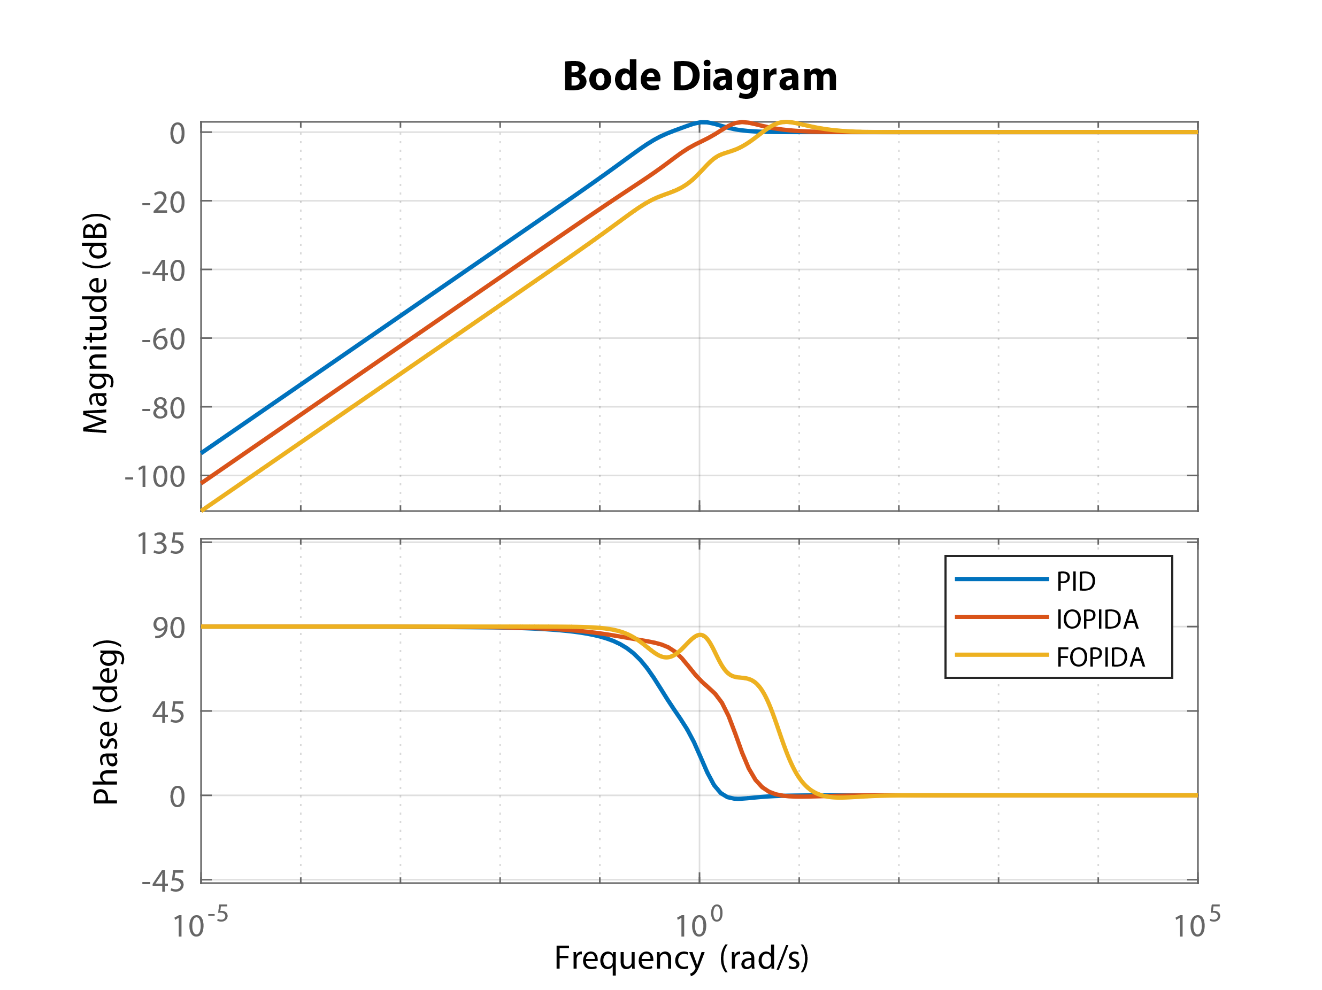

Slide 33
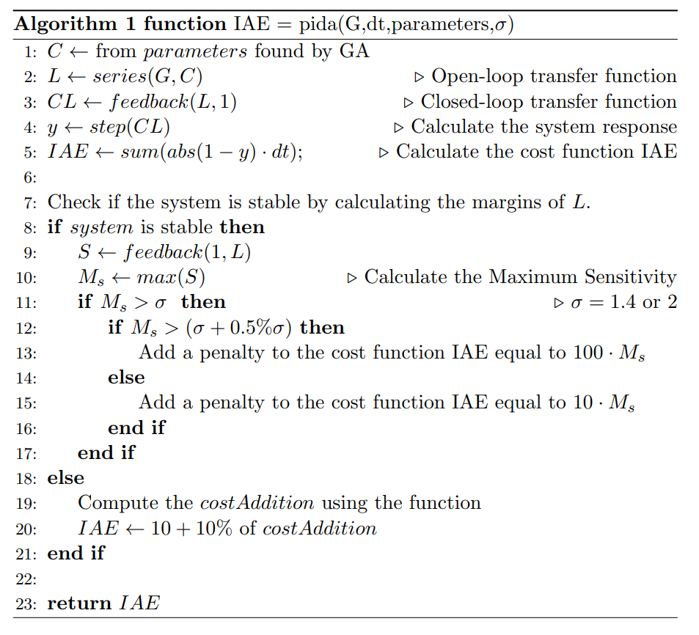



Tuning
Algorithm
Notes:
On the left side you can see the algorithm for the function IAE which the genetic algorithm needs to minimize.
It's worth noting that this algorithm is empirical in nature, and its success is based on practical observations rather than theoretical guarantees. However, through our experience and testing, we have found that it is a reliable and effective method for achieving the desired results.
First, the function receives the plant transfer function G, the time step dt, a set of tuning parameters found using a genetic algorithm, and a value sigma, which is selected by the user to be equal to 1.4 or 2.
After computing the open and closed loop transfer function we calculate the Integral Absolute Error.
The algorithm then checks if the system is stable by computing the margins of the open loop transfer function. If the system is stable, the maximum sensitivity M_s is calculated and compared to the value sigma. If M_s is greater than \sigma, a penalty is added to the cost function IAE. If M_s is greater than (\sigma + 0.5% \sigma), the penalty is $100\cdot M_s$, otherwise it is $10\cdot M_s$. In this way we are penalizing the genetic algorithm by a method that is proportionate to the maximum sensitivity. This means that we penalize the algorithm more when it is closer to the desired value. The goal is to enable the algorithm to identify the parameters that perfectly match the desired maximum sensitivity sigma.
If the system is not stable, we will proceed to calculate the crossover frequencies. Specifically, if these frequencies are found to be equal to 3, we will set the costAddition equal to the maximum gain that we have obtained from the bode plot. In this way the genetic algorithm will tend to shift down the frequency response and have just one cross over frequency.

Slide 34


Setpoint following
$$P_{5}\left(s\right)=\frac{1}{(s+1)(0.5s+1)({0.5}^{2}s+1)({0.5}^{3}s+1)}$$
2
Notes:
It is evident from the data presented that the PIDA system exhibits superior performance in comparison to PID, albeit with a slightly higher control variable.
However, I would like to delve further into this topic during my discussion on future research. I urge you not to be skeptical, as I will demonstrate that with appropriate tuning, this issue can be easily resolved even by continuing applying the acceleration action to the control error.

Slide 35


Notes:
This is still due to the presence of more zeros in the controller allows an increment of the bandwidth of the system but keeping the maximum sensitivity equal to the 1.4.

Slide 36

Load Disturbance Rejection
$$P_{5}\left(s\right)=\frac{1}{(s+1)(0.5s+1)({0.5}^{2}s+1)({0.5}^{3}s+1)}$$
2

Slide 37



Slide 38

Quantitative results
$$P_{2}\left(s\right)=\frac{1}{{\left(s+1\right)}^{8}} n=8$$
Set-point following
Load disturbance rejection
M
=
1
.
4
M
=
2
M
=
1
.
s
s
s
4
M
=
2
s
PID
PIDA
PID
PIDA
PID
PIDA
PID
PIDA
IAE
9.89
5.60
6.28
37.3 %
25.8 %
43.4 %
3.94
8.12
4.83
5.59
4.15
40.5 %
K
0.38
0.99
0.89
1.74
0.56
1.20
0.92
1.47
p
T
3.27
4.55
4.63
6.15
3.58
5.20
4.31
5.98
i
T
2.23
3.98
2.47
2.67
2.66
3.18
2.66
1.87
d
T
-
6.44
-
5.26
-
5.78
-
2.49
a
N
2.012
2.11
52.45
2.41
111.38
2.20
109.56
7.22
α
-
56.073
-
72.63
-
152.74
-
8.60
Notes:
Upon examining the results for multiple equal poles, specifically with n equal to 8, we can clearly see a significant advantage. This advantage can be attributed to the higher value of the acceleration action. This bring to a gain of about 40 % in terms of IAE.

